Slide 1
SOFTWARE GROUP PROJECT
GROUP MEMBERS:
KIRTAN PATEL(19DCE103) VISHESH PATEL(19DCE117)
TRAVEL WEBSITE

Slide 2
INDEX:
INTRODUCTION
PURPOSE
SCOPE
IMPORTANCE AND ROLE
REQUIREMENT GATHERING TECHNIQUES USED
HARDWARE AND SOFTWARE REQUIREMENT
TOOLS AND TECHONOLOGY
SCREENSHOTS
REFERENCES

Slide 3
INTRODUCTION:
TRAVEL WEBSITE:
A travel website is a site that contains all information about distinct travel destinations such as images, fares, hotels and their charges, customer reviews, modes of transportation etc.
So in our project we have tried to accumulate all the above mentioned ideas to make it a creative project.

Slide 4
PURPOSE
The Purpose of the website to create a growth in online business. Customers can easily book party plot from the website. The intention behind the development of this project is to attract businessman and customers from thee same industry so that the firm can get business and recognition and hence establish itself as a worthy competitor in the part plot business.
The website gives you control over image of your party plot. This is the platform to tell their own story, in their own words. Customers will get a good idea on party plot, as well as get an idea of the overall atmosphere of the party plot.

Slide 5
SCOPE OF SYSTEM:
The scope of travelling website is increasing day by day as it provide great employment oppurtunities as there are many big companies like makemytrip making huge profits and there are enormous travelling websites which provide job to many people as it also helps computer engineers like us to maintain and deal with the server of travelling website in order that it functions effectively.

Slide 6
IMPORTANCE AND ROLE OF TRAVEL WEBSITE:
1)Improves company’s value:
Many user nowadays predict about a company by visiting their website and if a company contains a website its value increases in eyes of people.
2)Provides deep knowledge:
Travel website provides with knowledge about whole tourist destination and people get to choose which place are suitable for them for an enjoying vacation and it helps create a visual impact on people.

Slide 7
3)Client reviews:
In the review section people can get and add their review about different tourist spots and which is read by thousands of people so due to this people can choose their destination accordingly and the company will provide their best for a positive review.
4)Ease of access:
It gives customers ease of access and they do not need to travel to different places to book their trip and they can book it from anywhere and anytime they want.

Slide 8
5) Growth in bussiness and jobs:
Travel websites are:
1. trustworthy,
2. attract people with your engaging content, 3. help travelers find their perfect choice with the least possible efforts, Due to this, companies earn huge profits and many people get job oppurtunities in this field.

Slide 9
REQUIREMENT GATHERING TECHNIQUES USED:
HTML-5
CSS-3
JAVASCRIPT/ JQUERY
SUBLIMETEXT EDITOR
SEVERAL OTHER TUTORIALS
BOOTSTRAP (Fonts/Transitions)
XAMPP(LOCAL HOST)/PHP-MY ADMIN
MY SQL
VISUAL STUDIO CODE

Slide 10
HARDWARE AND SOFTWARE REQUIREMENT:
HARDWARE:
Mostly for creating and maintaining a travel website you need a pc/laptop which supports latest applications and a good wifi connection.
SOFTWARE:
We used software applications like sublimetext editor, google chrome etc.

Slide 11
TOOLS AND TECHNOLOGY:
SUBLIME TEXT EDITOR:
We used concept mainly of HTML and CSS to create our website which was made possible by sublime text editor used for our coding and save the file . It supports many programming and markup languages as it contains a source code editor with a python application programming interface.
BOOTSTRAP:
We Used BootStrap for give some transitions and effect for our web pages. It is like a library file which contains all features of designing. We also add logo like mobile, envelope, house, FB, Twitter, etc. for improve its look.

Slide 12
JavaScript/Jquery:
JavaScript is one of the core languagies of the world wide web. JavaScript enables interactive web pages and is an essential part of web applications. The vast majority of websites use it for client-side page behavior and all major web browsers have a dedicated JavaScript
engine to execute it.

Slide 13
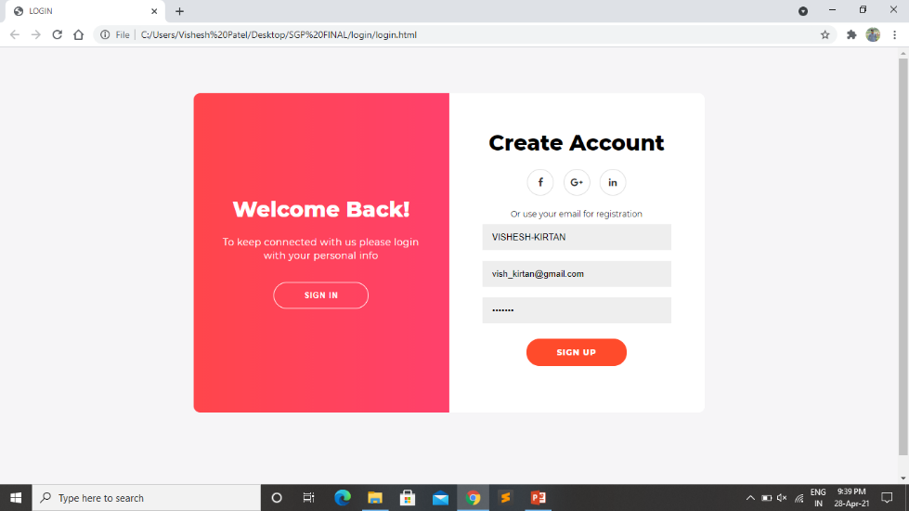
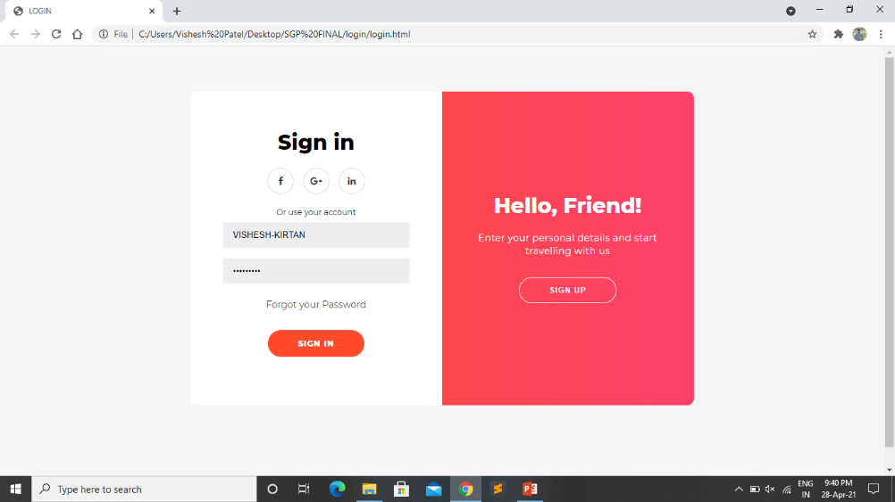
SCREENSHOTS:
Sign up
Section
Sign in
Section

Slide 14
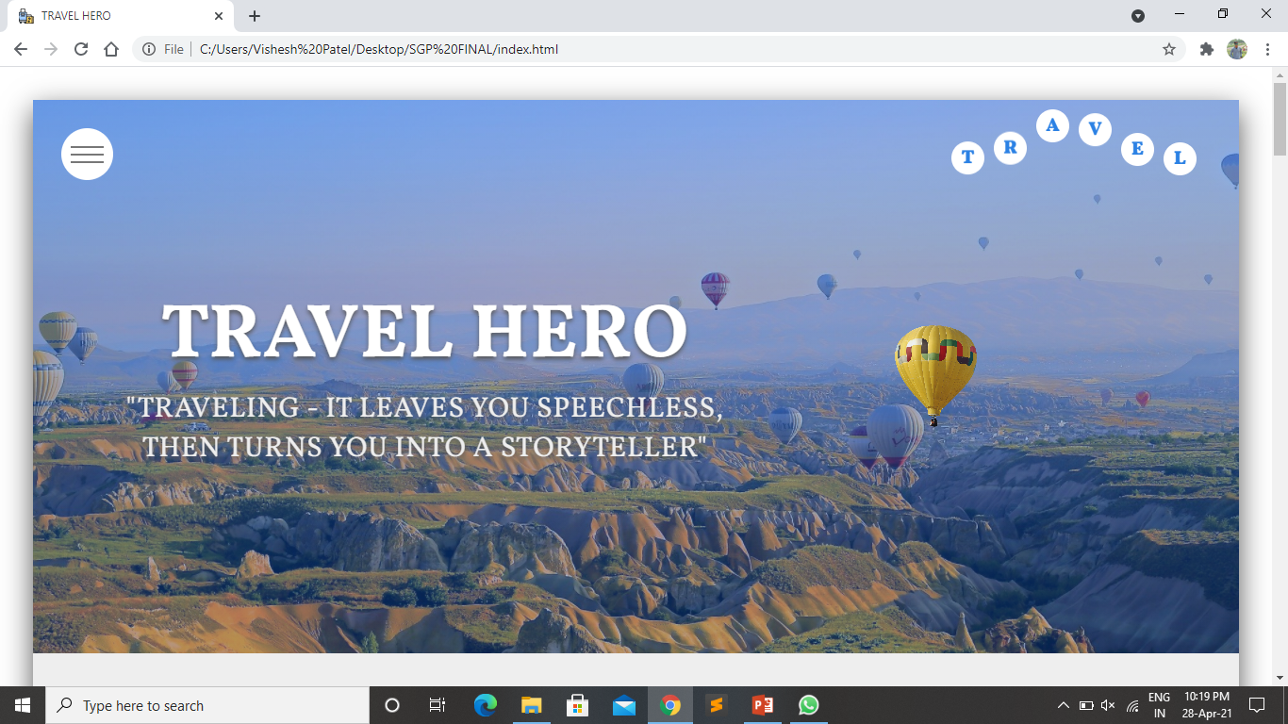
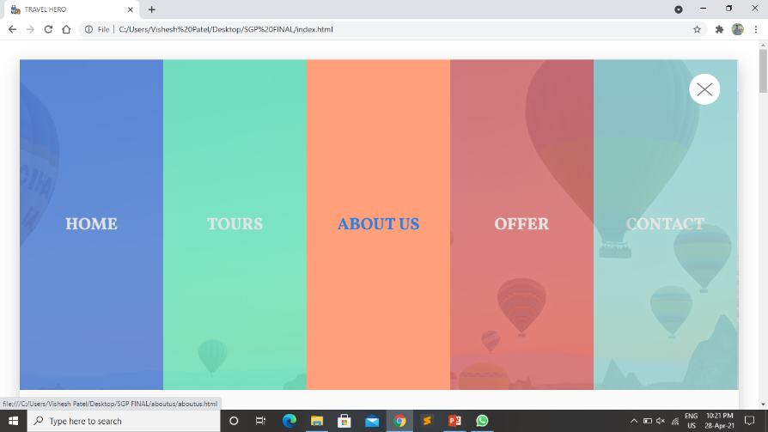
Section 1
Navbar
Section

Slide 15
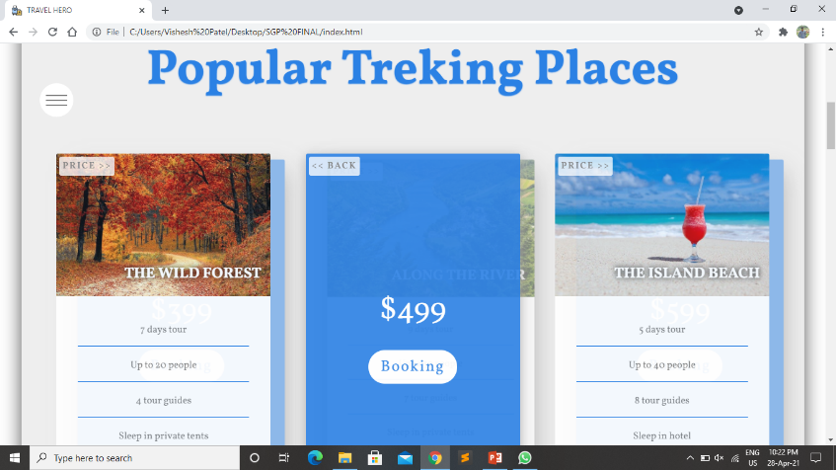
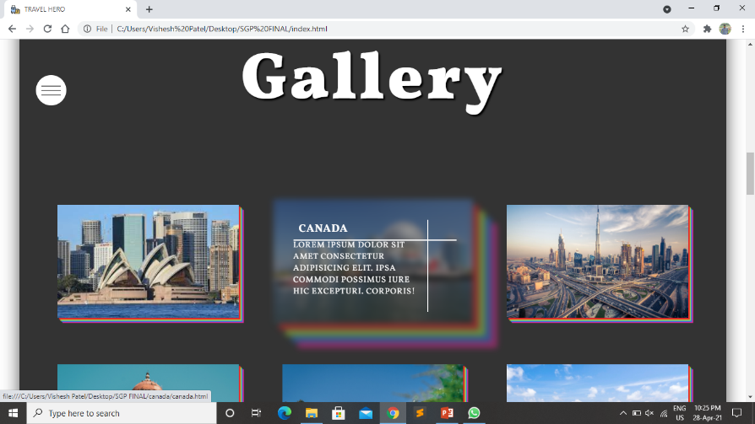
Section 2
Gallery Section

Slide 16
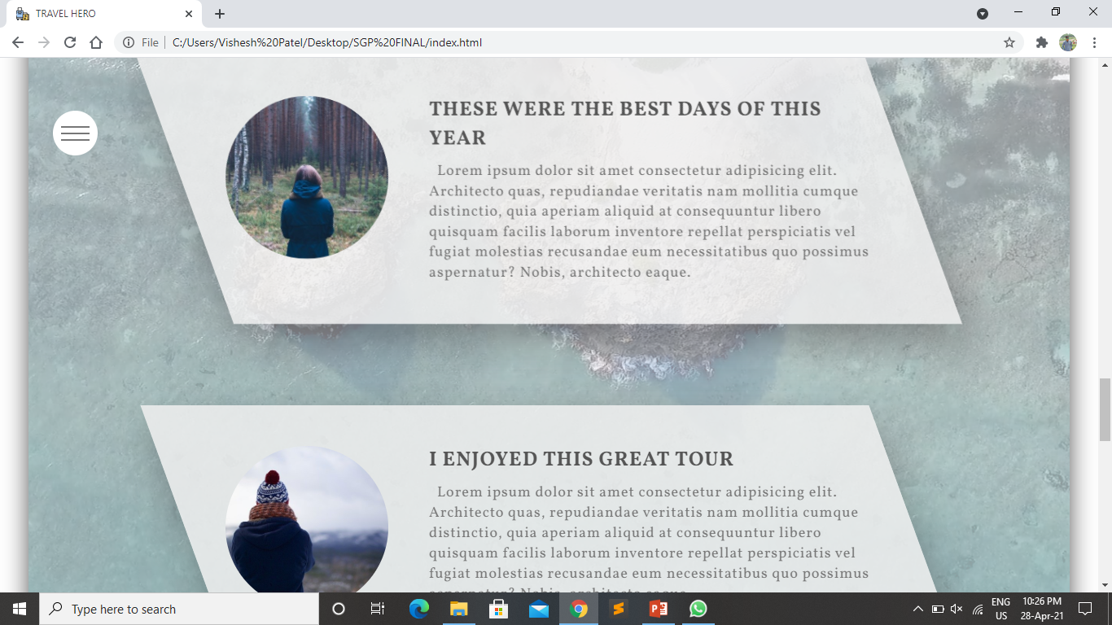
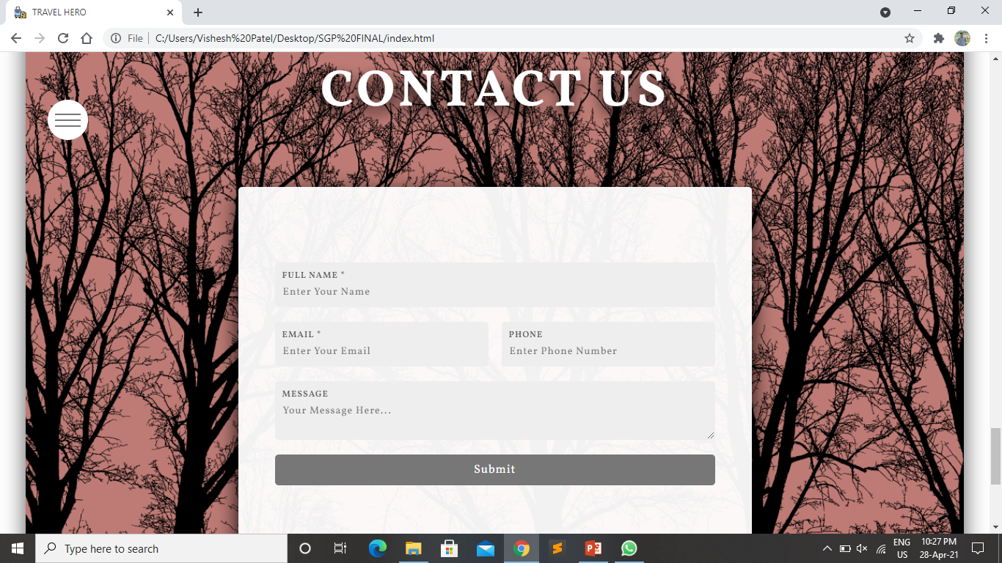
Review
Section
Contact Section

Slide 17
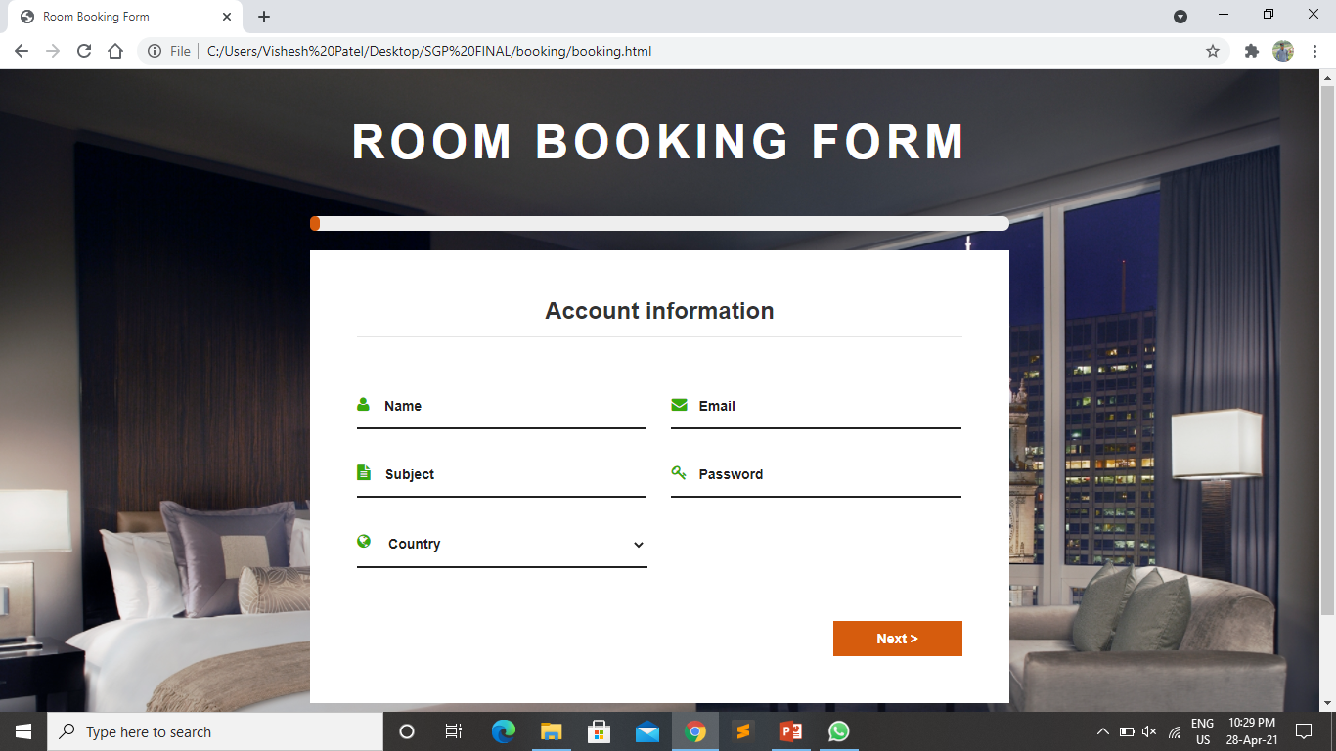
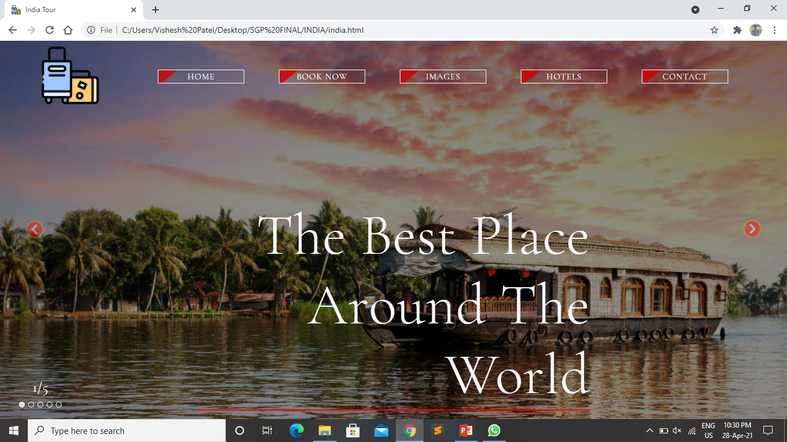
Booking
Page
Place
Main

Slide 18
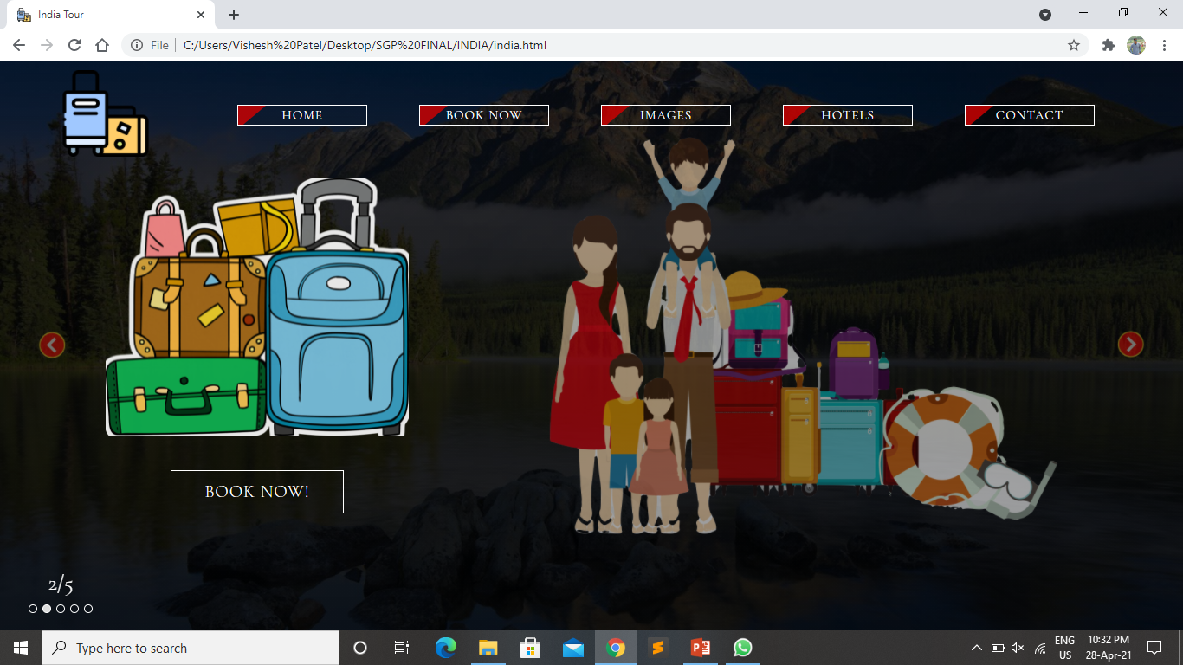
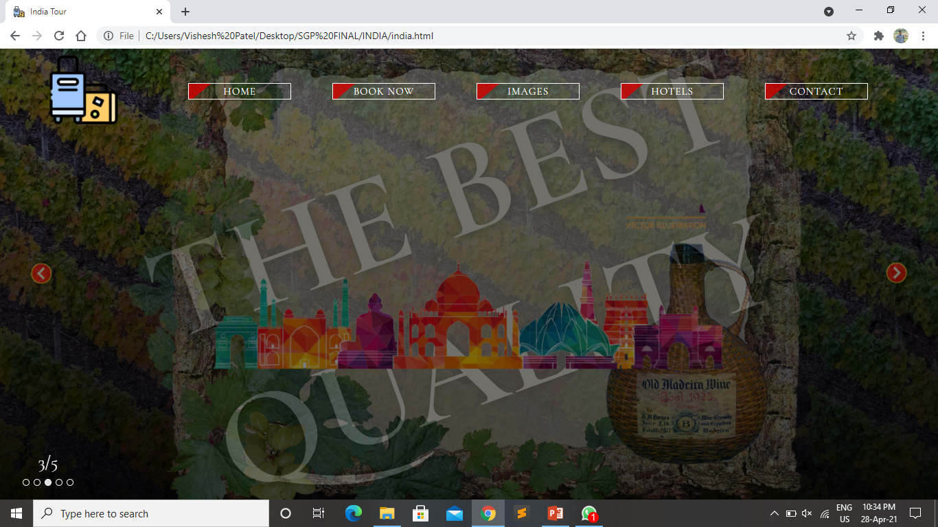
Booking
Page
Image
Section

Slide 19
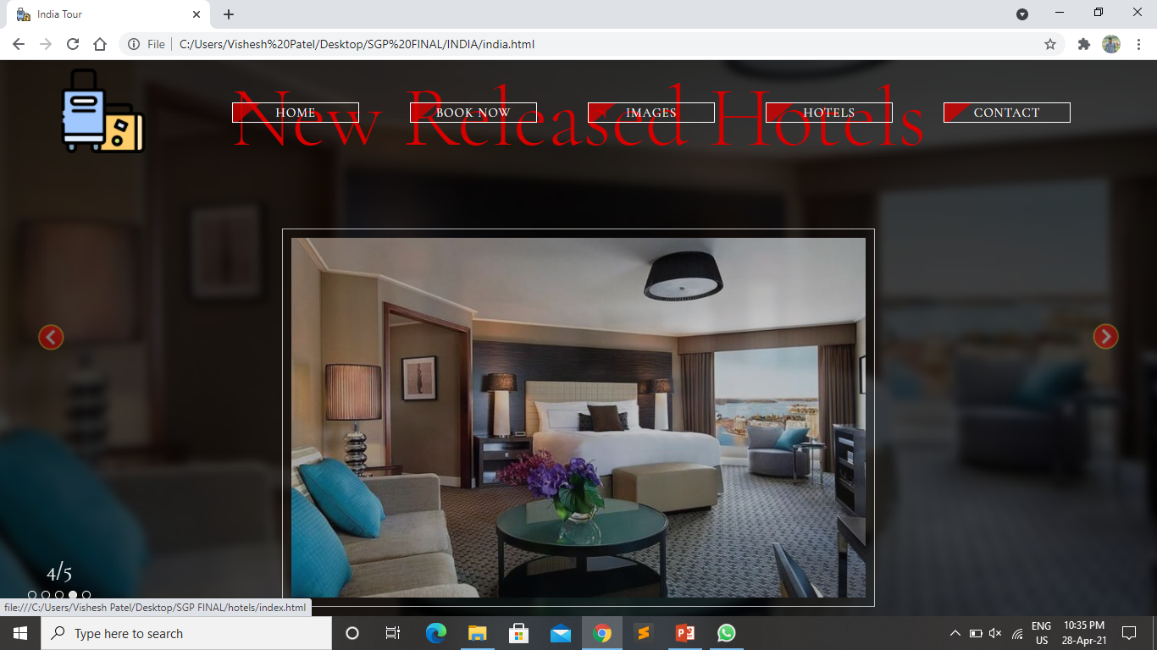
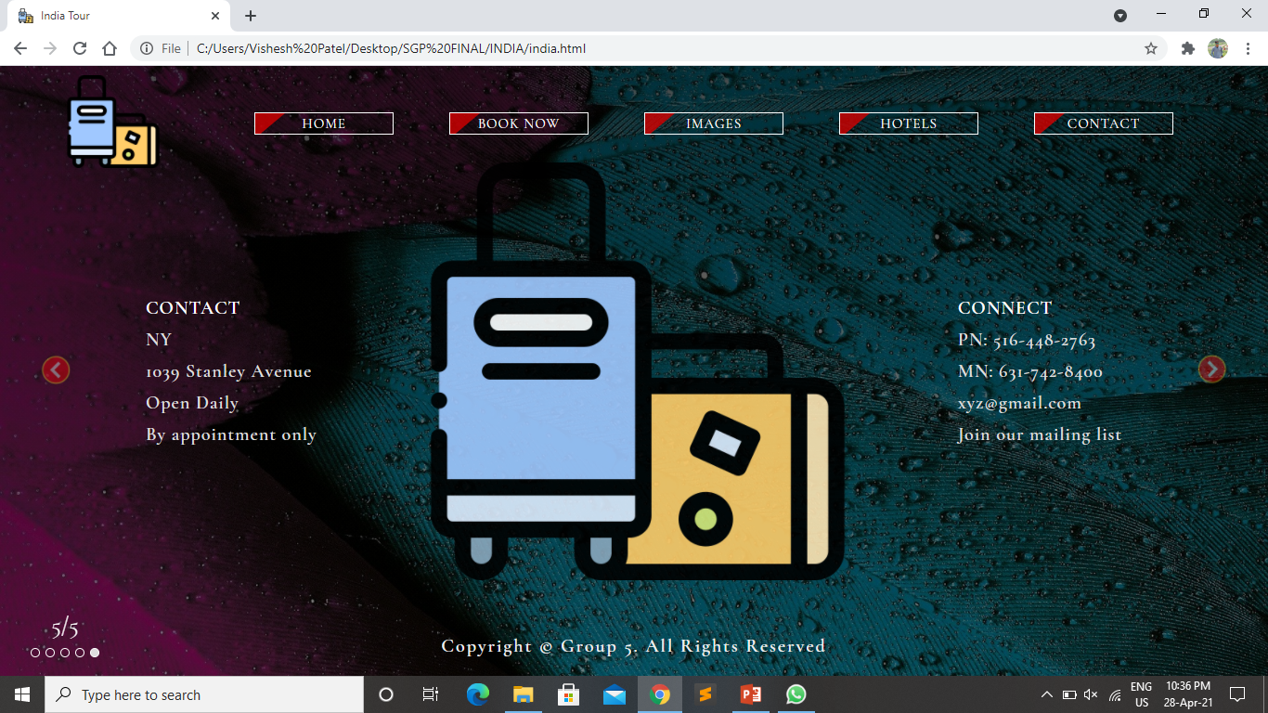
Hotel
Section
Review
Section

Slide 20
REFERENCES:
www.w3schools.com
www.google.com
www.tutorialspoint.com
www.javatpoint.com

Slide 21
THANKYOU

